Slide 1
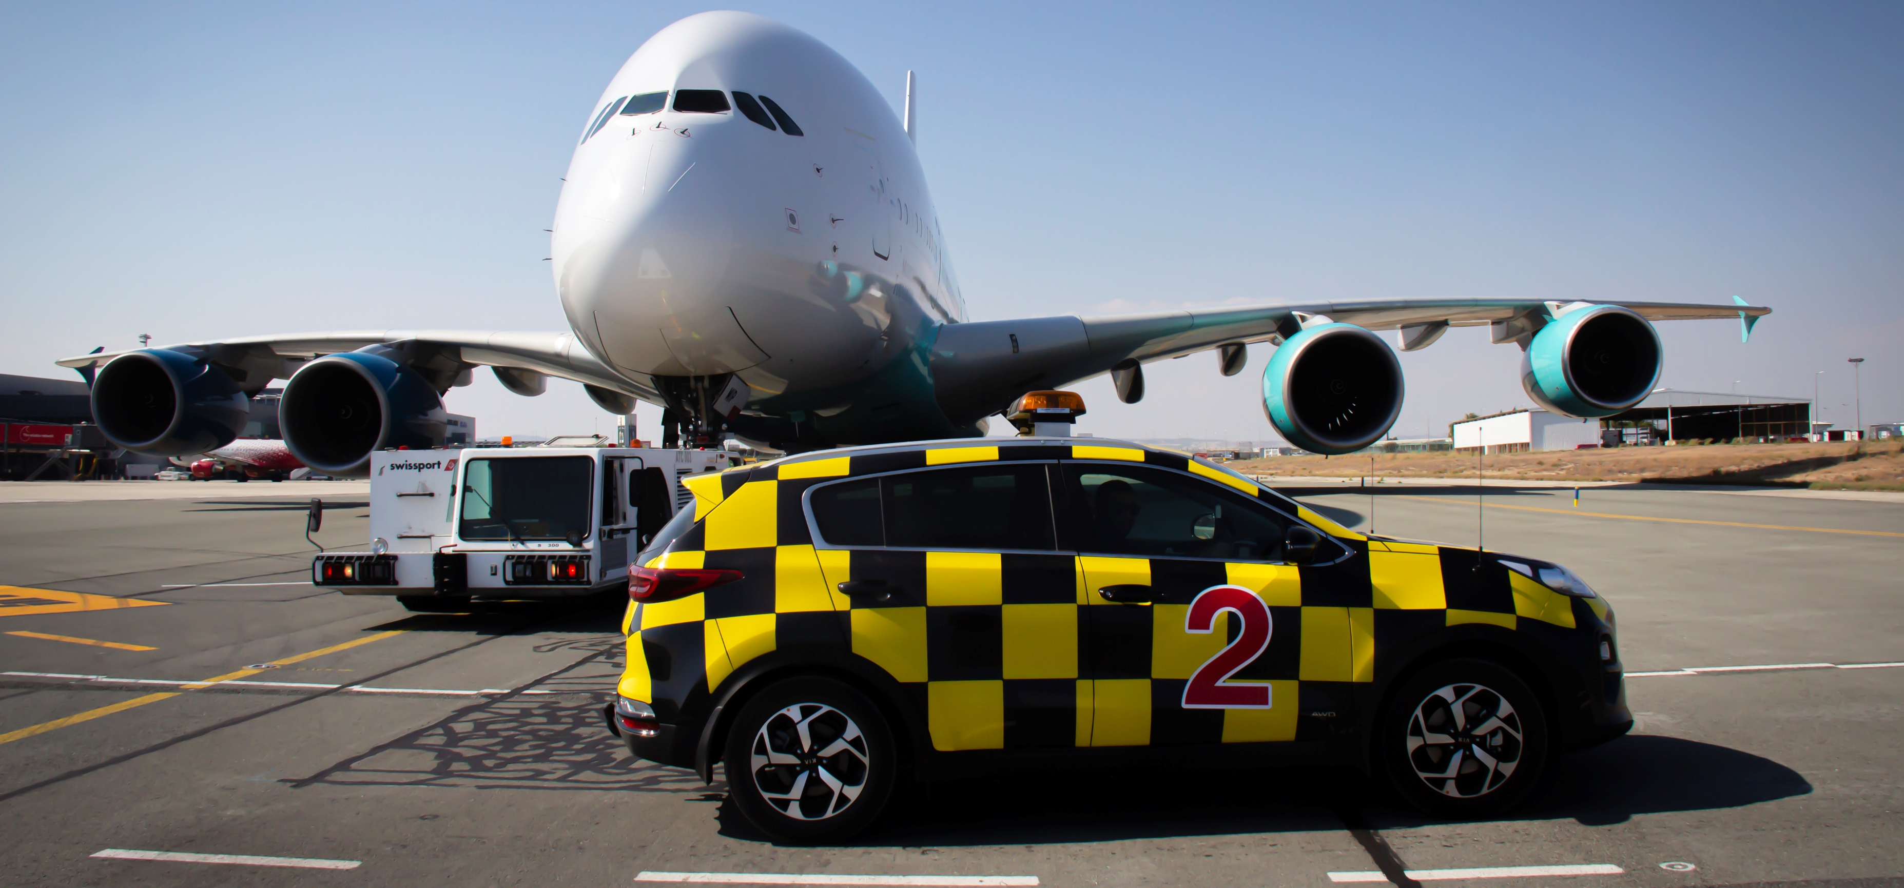

Impact of COVID-19 on Airport Operations
Constantinos Ioannides
Team Leader Operations Center & Security Contracts Management

Slide 2
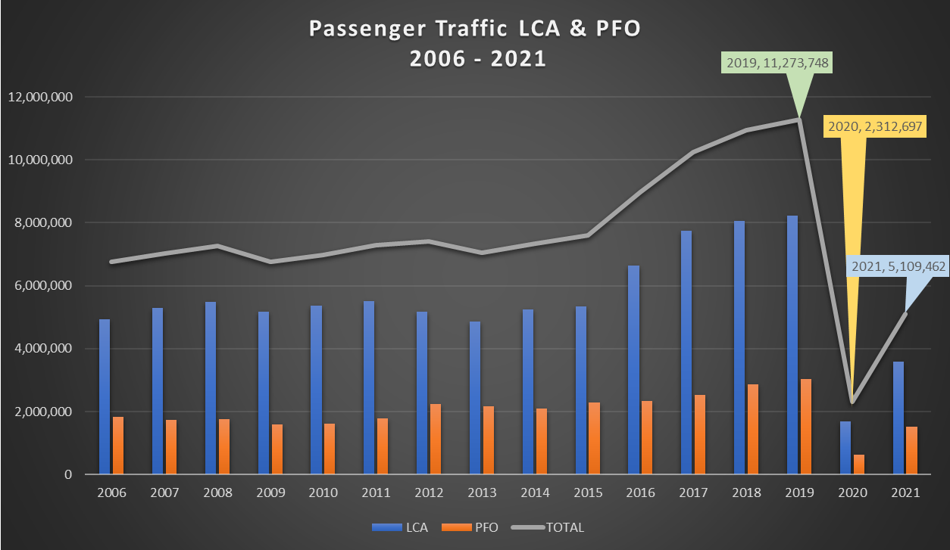
Passenger Traffic LCA & PFO 2006 - 2021

Slide 3
Timeline of government policy decisions in response to the COVID‐19 pandemic - 2020
16 March
20 March
9 June
20 June
Entrance to the country prohibited to non residents
Negative COVID-19 test required
All incoming passenger flights forbidden.
Only cargo flights, humanitarian, ambulance, repatriation flights allowed.
Passengers from countries characterised as low or average transmission can enter Cyprus with a negative COVID-19 test.
CyprusFlightPass introduced.
Passengers from countries characterised as low transmission can enter Cyprus without a test.
Random testing of flights introduced.
03 December
Action Plan for the gradual resumption of flights and the reopening of airports
Effective 01 March 2021

Slide 4
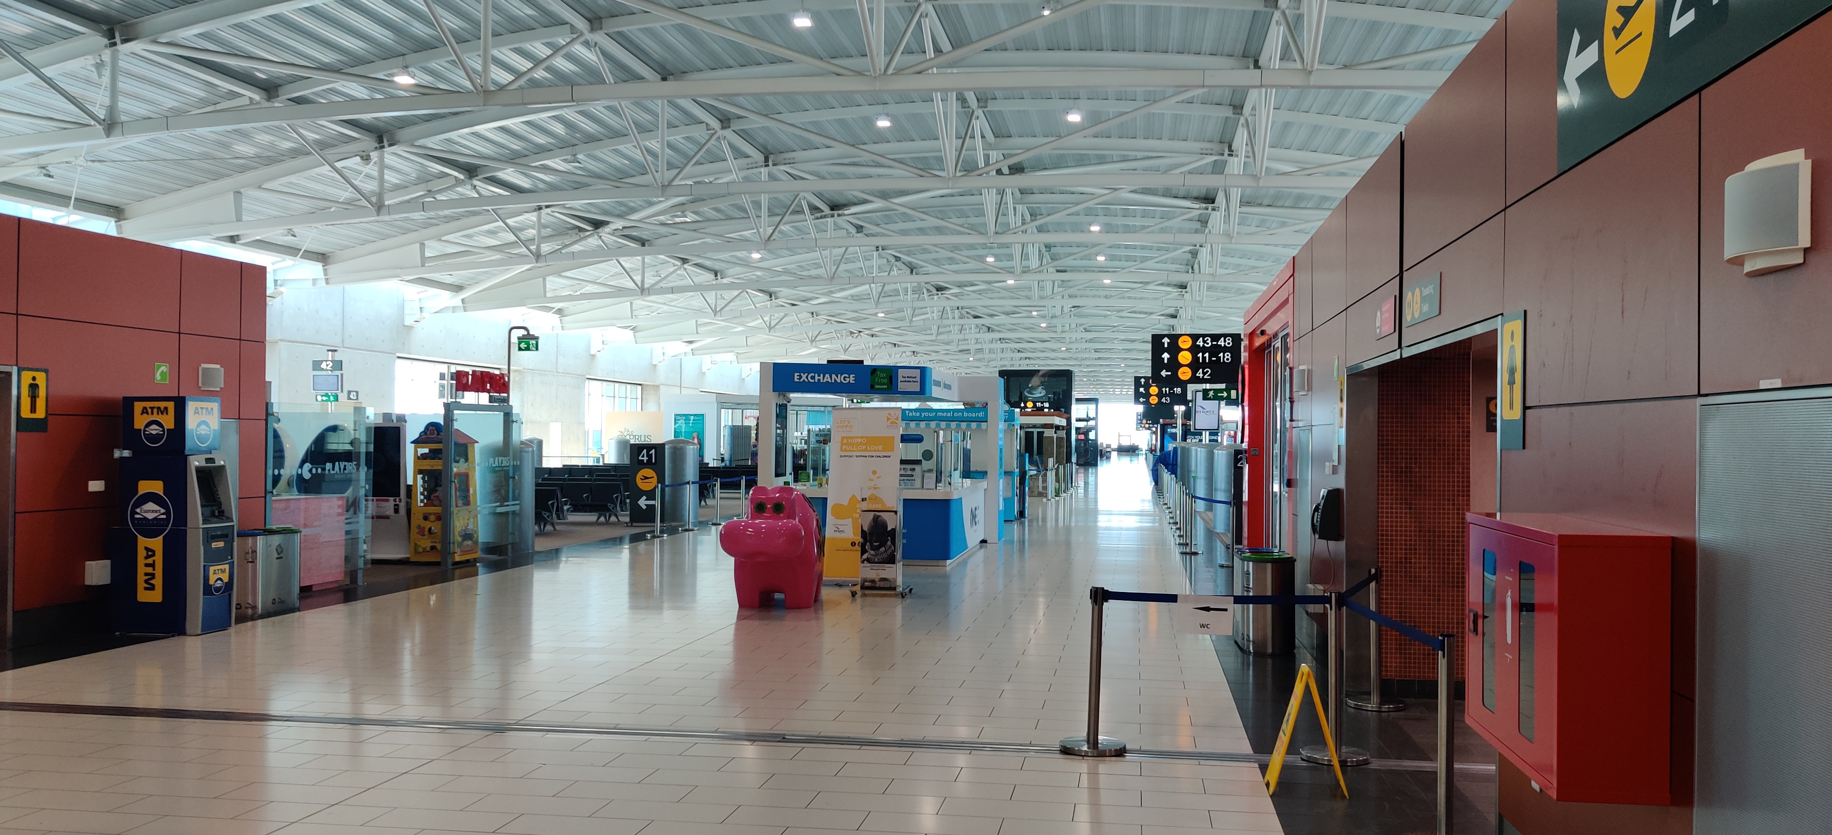
Airport during the flight ban - 2020

Slide 5
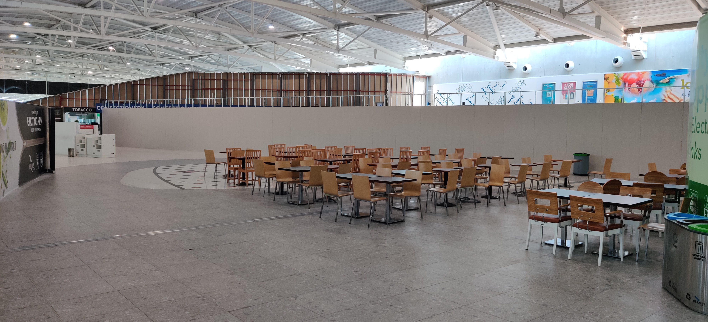
Airport during the flight ban - 2020

Slide 6
Timeline of government policy decisions in response to the COVID‐19 pandemic - 2020
16 March
20 March
9 June
20 June
Entrance to the country prohibited to non residents
Negative COVID-19 test required
All incoming passenger flights forbidden.
Only cargo flights, humanitarian, ambulance, repatriation flights allowed.
Passengers from countries characterised as low or average transmission can enter Cyprus with a negative COVID-19 test.
CyprusFlightPass introduced.
Passengers from countries characterised as low transmission can enter Cyprus without a test.
Random testing of flights introduced.
03 December
Action Plan for the gradual resumption of flights and the reopening of airports
Effective 01 March 2021

Slide 7
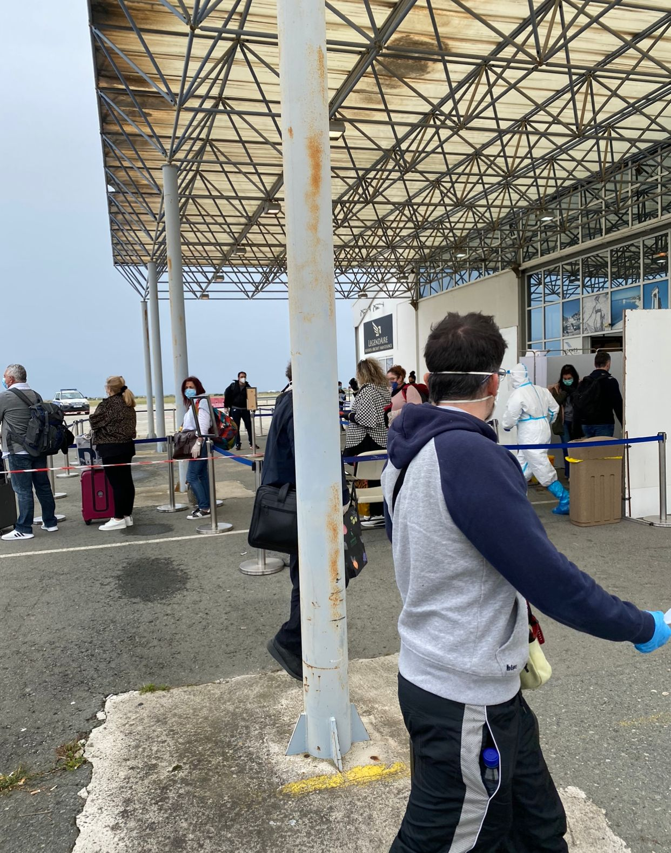
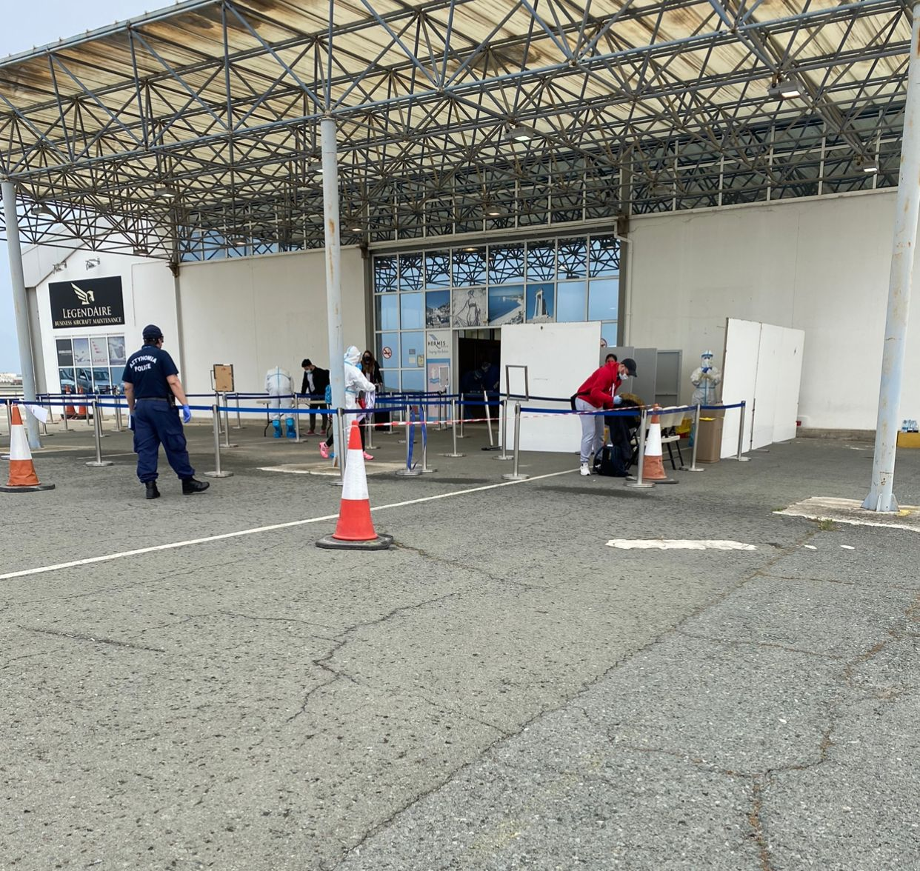
Airport facilities converted to COVID-19 testing areas

Slide 8
Timeline of government policy decisions in response to the COVID‐19 pandemic - 2020
16 March
20 March
9 June
20 June
Entrance to the country prohibited to non residents
Negative COVID-19 test required
All incoming passenger flights forbidden.
Only cargo flights, humanitarian, ambulance, repatriation flights allowed.
Passengers from countries characterised as low or average transmission can enter Cyprus with a negative COVID-19 test.
CyprusFlightPass introduced.
Passengers from countries characterised as low transmission can enter Cyprus without a test.
Random testing of flights introduced.
03 December
Action Plan for the gradual resumption of flights and the reopening of airports
Effective 01 March 2021

Slide 9
Airport facilities converted to COVID-19 testing areas

Slide 10
Timeline of government policy decisions in response to the COVID‐19 pandemic - 2020
16 March
20 March
9 June
20 June
Entrance to the country prohibited to non residents
Negative COVID-19 test required
All incoming passenger flights forbidden.
Only cargo flights, humanitarian, ambulance, repatriation flights allowed.
Passengers from countries characterised as low or average transmission can enter Cyprus with a negative COVID-19 test.
CyprusFlightPass introduced.
Passengers from countries characterised as low transmission can enter Cyprus without a test.
Random testing of flights introduced.
03 December
Action Plan for the gradual resumption of flights and the reopening of airports
Effective 01 March 2021

Slide 11
Updated Action Plan for the gradual resumption of flights
Updated Action Plan for the gradual resumption of flights and the reopening of airports – Effective 01 March 2021
Risk classification of states to follow the ECDC categorisation (Green, Orange, Red, Grey)
Green Category - No restrictions in force
Orange Category - Negative PCR laboratory testing is required within 72 hours before departure.
Red Category - Double laboratory testing is required, that is, a negative PCR examination within 72 hours prior to departure and yet another laboratory PCR testing upon arrival in Cyprus. No self-isolation/quarantine measures are valid in this category.
Special Permit Category (Grey) - Negative PCR test within 72 hours prior to departure. In this category, measures of self-isolation/quarantine shall apply in line with the instructions by the Health Minister.
Challenge:
Facilitate traffic growth while implementing COVID-19 protection measures, assuring safety, continuity of operations and compliance with regulations

Slide 12
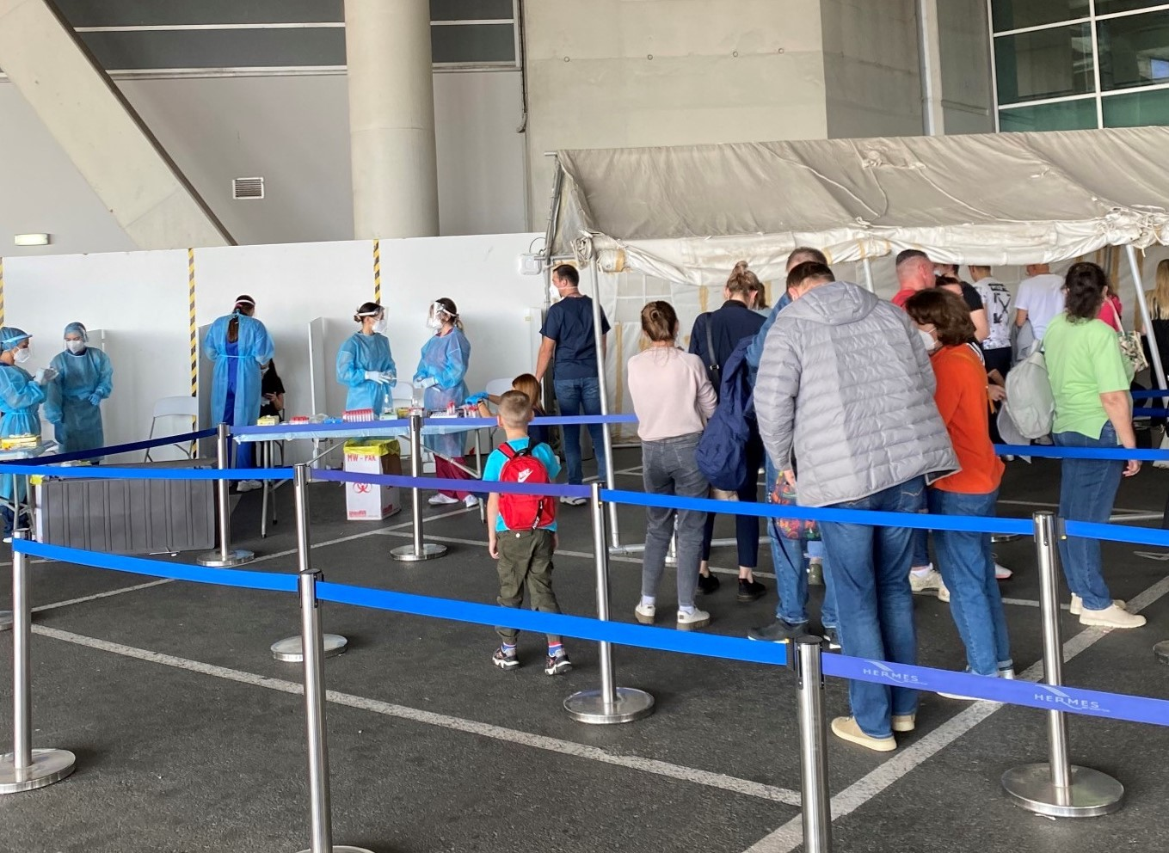
Managing during COVID-19 – 2021 – LCA & PFO
Areas of focus
  Created additional COVID-19 test areas – 7 in total at LCA and 5 at PFO
  Facilitated segregation of passengers via Services Agreement with a private organisation and with the Ministry of Transport.
  Ensuring H&S Protocol is uniformly implemented by all airport stakeholders
  Maintaining compliance on all regulatory operational matters

Slide 13
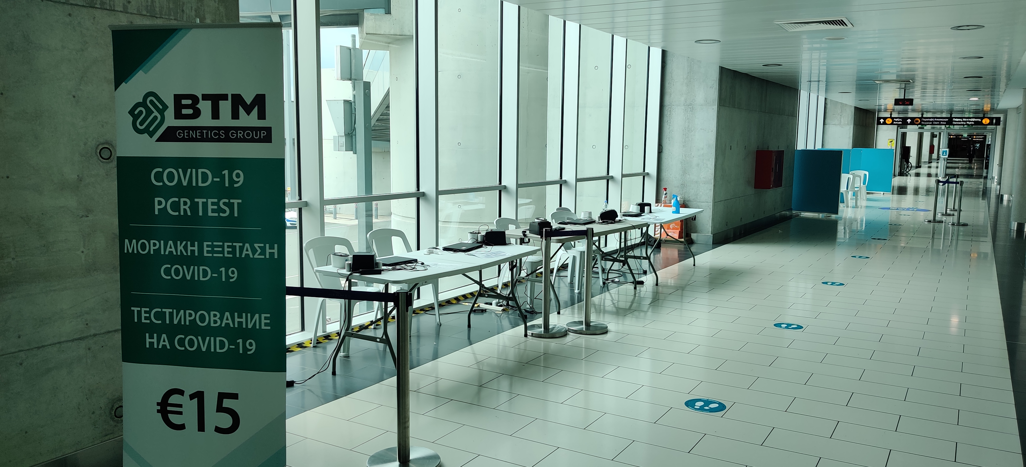
Managing during COVID-19 – 2021 – LCA & PFO
Areas of focus
  COVID-19 Test areas at LCA gradually increased to 12 in total to maintain the level of services.
  Daily coordination meetings with all involved stakeholders
  New Standard Operating Procedures were developed in collaboration with the airport community.
Airport Coordination Team
Police
Health Services
Airlines
Ground Handlers
Private Security
Hermes

Slide 14
Managing during COVID-19 – LCA & PFO

Slide 15
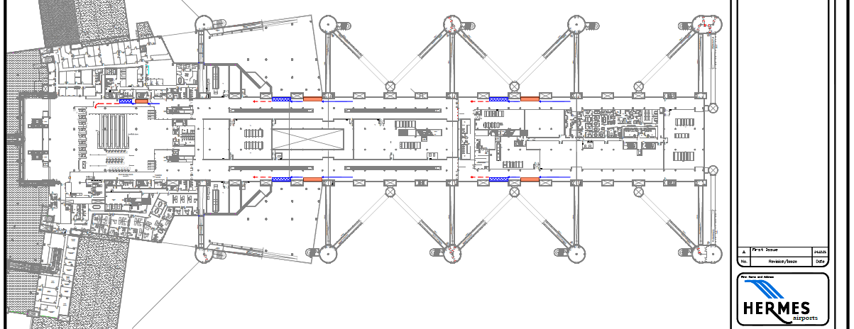
Managing during COVID-19 – LCA & PFO

Slide 16
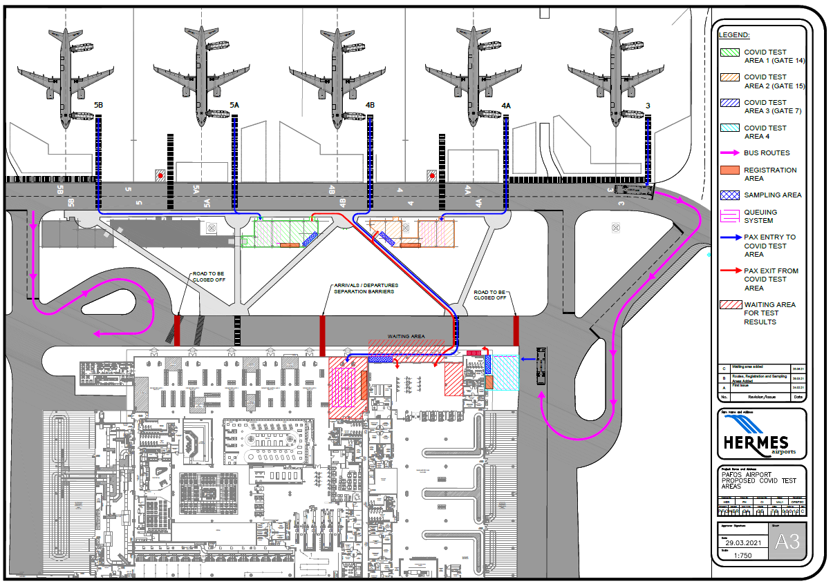
Managing during COVID-19 – LCA & PFO

Slide 17
Isolation of Category Red Country Passengers for rapid testing

Slide 18
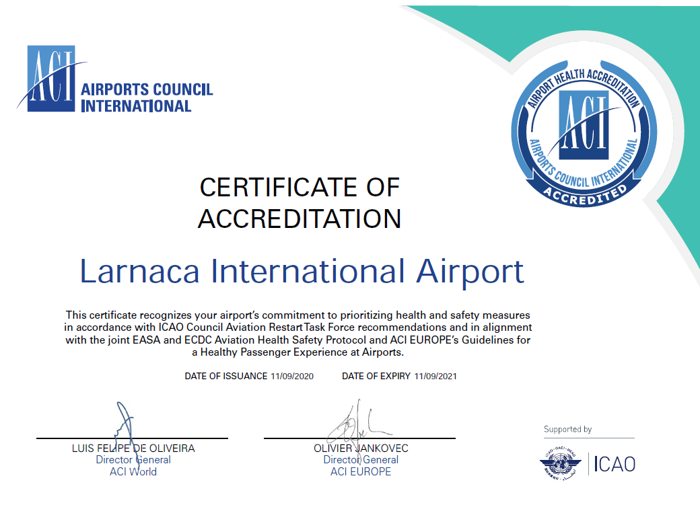
ACI Airport Health Accreditation
Notes:
Following the submission of a relevant application to Airports Council International (ACI) in November 2020, both Larnaka and Pafos Airports were accredited with aligning our health safety measures with the ACI Aviation Business Restart and Recovery guidelines and the ICAO Council Aviation Restart Task Force recommendations. This clearly demonstrates that both airports implement industry health and safety best practices to protect both passengers and staff. This program also aims to reassure the travelling public that airport facilities remain safe and that all necessary precautions are being taken to minimize any risk to their health.

Slide 19
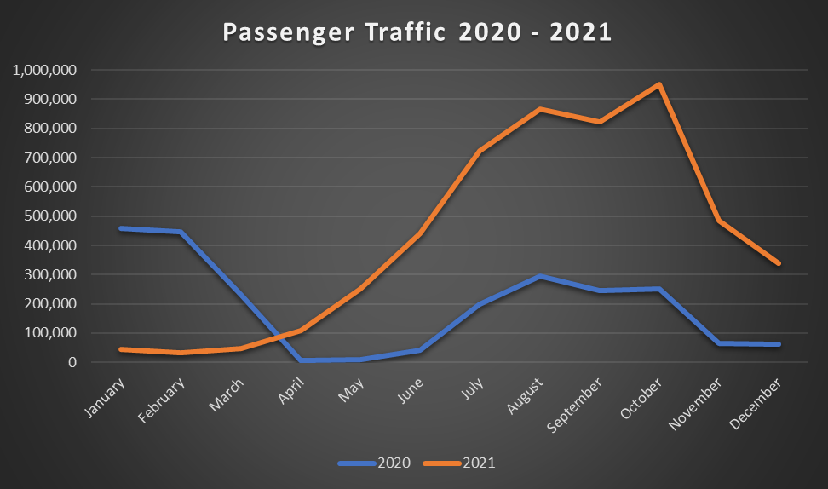
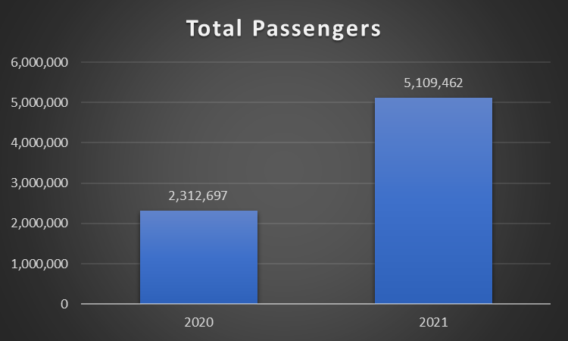
Passenger Traffic 2020 - 2021

Slide 20
Thank You

